Slide 1



GENDER BASED VIOLENCE PROJECT DASHBOARD
View in Power BI
Last data refresh:
1/29/2024 3:52:07 PM UTC
Downloaded at:
1/29/2024 4:41:05 PM UTC

Slide 2
Definition
Gender-based violence (GBV) is violence committed against a person because of his or her sex or gender. It is forcing another person to do something against his or her will through violence, coercion, threats, deception, cultural expectations, or economic means. Although the majority of survivors of GBV are girls and women, LGBTIQ+, boys and men can also be targeted through GBV.

Slide 3
Main Forms of gender-based violence
Sexual violence is any act, attempted or threatened, that is sexual in nature and carried out without the consent of the victim. Sexual violence includes rape, sexual abuse and harassment, exploitation, and forced prostitution. It can happen within marriages, especially when there is a lack of consent for sexual activity by one of the spouses. Physical violence is any physical, sexual, psychological, verbal and economic violence between one person and another within the family. It may be committed by family members and/or people considered as family members, whether or not they live in the same household.

Slide 4
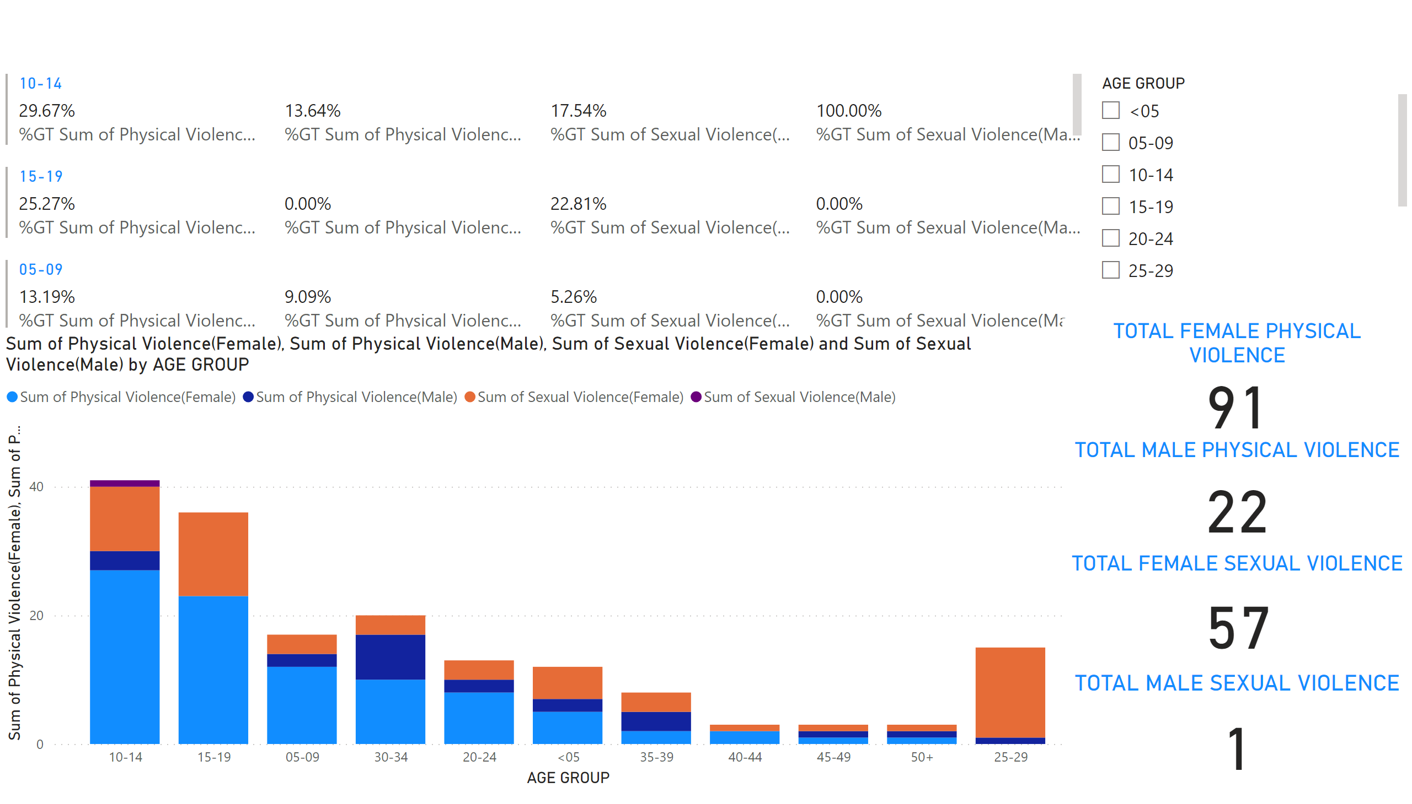
GENDER BASED VIOLENCE
Notes:
columnChart
No alt text provided
multiRowCard
No alt text provided
TOTAL FEMALE PHYSICAL VIOLENCE
No alt text provided
TOTAL MALE PHYSICAL VIOLENCE
No alt text provided
TOTAL FEMALE SEXUAL VIOLENCE
No alt text provided
TOTAL MALE SEXUAL VIOLENCE
No alt text provided
slicer
No alt text provided

Slide 5
Pivot Chart

Slide 6
Insights
The visulization and graph show that women and young girls are more affected by gender based violence than men. This number help government and non goverment organization to plan on how to reduce and eradicate GBV especially to the young women such as to initiate various programs to make awareness to the communities.

